Slide 1
Welcome to Digital Media Workshop
All about Social Media
By Make it Market Drayton

Slide 2
What we’ll be covering:
We’re going to go through some slides together and then onto something practical and fill in workbooks together!
Notes:
How presentation will benefit audience: Adult learners are more interested in a subject if they know how or why it is important to them.
Presenter’s level of expertise in the subject: Briefly state your credentials in this area, or explain why participants should listen to you.

Slide 3
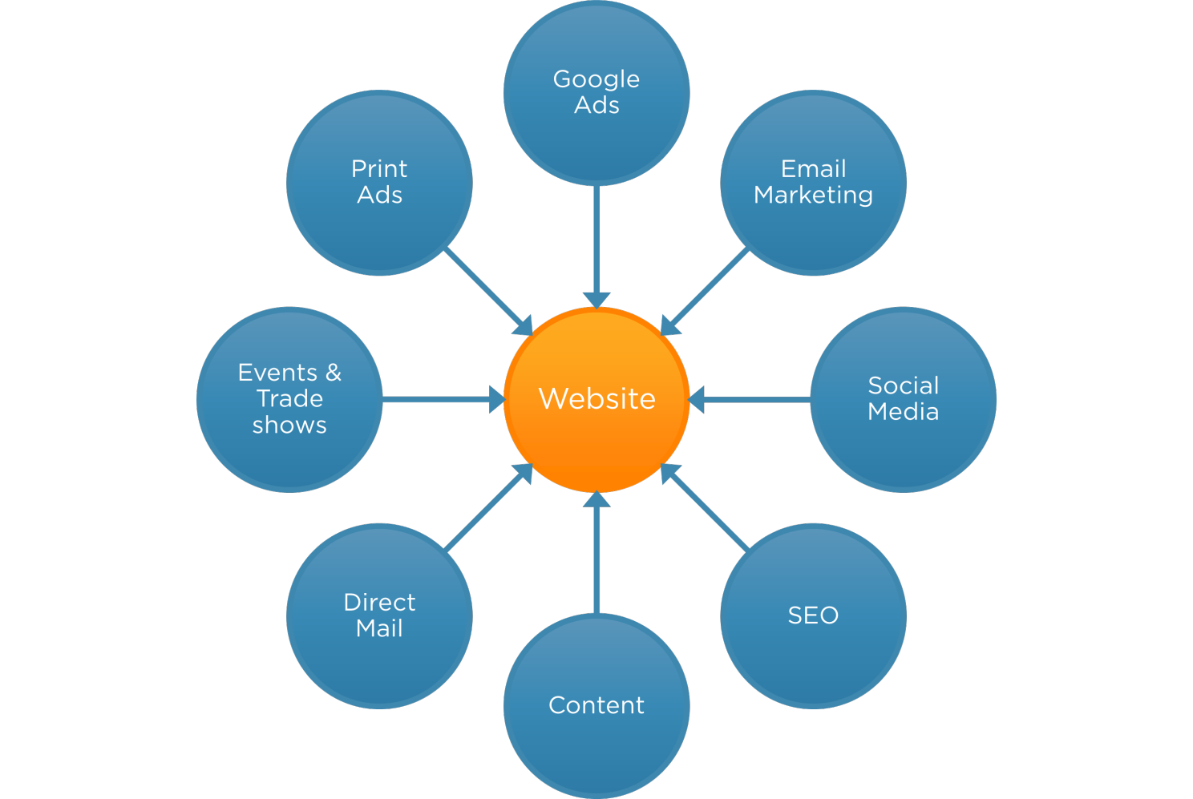
But what’s the relationship between your website and social media?
The better your website the more impact your social media will have..
The better your social media campaigns the more your website will be read… again… and again…
And the more likely your website is to find in search engines like Google…
And the more customers will find you.

Slide 4
Not just a website… a GREAT website – according to AI
Responsive – has to be mobile friendly – 86% of adults in the UK look at websites on their phone! – That’s bigger than social media!
Speed – google likes faster websites
SEO Friendly - it’s all about the words
Quality & Regular content – Google loves it when you post and use keywords
Keywords – are they on your home page?
Linking – google loves it when you link to others
Social sharing – googles loves it when you share from your site
Maintenance & Updated – Got to keep it updated
Monitor – Google can help you with this
Now handing over to you… how good is your website?

Slide 5

Website content is no longer King…

Slide 6

It’s King Kong
Creating unique content on a regular basis on your website is the best and most important thing you can do to get your website found in search engines AND grow your customers.

Slide 7
Limitations of just using Social Media – according to AI
Limited Control and Ownership
  Dependent upon their rules and algorithms
Branding & Customisation
  Difficult to stand out!
Content Restrictions
  Limitations on what you say and number of characters
SEO
  Less likely to get found in search engines
Analytics & Insights
  There’s some but not a lot of info
Sales & Ecommerce
  Can be tricky
Customer Experience
  Very limited
Content Performance
  Very low life span
Flexibility & Adaptability
  Very limited
Advertising Costs
  Can be costly over time

Slide 8
And there’s one more…. Not everyone uses it!
Facebook – 44% of people in the UK use Facebook on a day to day basis – and is the most popular!
  Usually aged between 13-34
  52% women
  Use it multiple times in a day – will explain why this is important later!
X (Twitter) – 23% of people in the UK use Facebook on a day to day basis – and is the most popular!
  Usually aged between 18-29
  Used for instant news (and complaining)
Instagram– 43% of people in the UK use Instagram on a day to day basis
  Mainly under 35 years old
  Used more in urban areas – great for discovering new products
LinkedIn– 29% of people in the UK actively use LinkedIn
  Mainly professionals, higher income and education
  Great for networking and searching for jobs
YouTube
  Youtube is the second largest search engine in the world (after Google). “Let’s Youtube it”
  Great for learning – and entertaining
  Used by everyone!

Slide 9

The 3 Golden Rules about Social Media
It’s about Customer Engagement (not selling) so ask questions, start conversations, involve people. (It’s not all about you)
Always, always, always link back to your website (social media is the avenue to getting people to your website). It’s the alternative to opening a door to your shop.
Be sociable – it’s social media afterall, take your message and share and don’t just rely on your own customer base.
But why? Answer is the importance of links!

Slide 10

Task: Writing Content
Think of topics for content that you can write about WITHOUT ‘selling’ your products or services....
… for example:
Writing about money saving tips for a credit union
Writing about the benefits of therapies etc
Writing about where your products come up, how it’s made etc.
Then ask AI to create it for you…

Slide 11
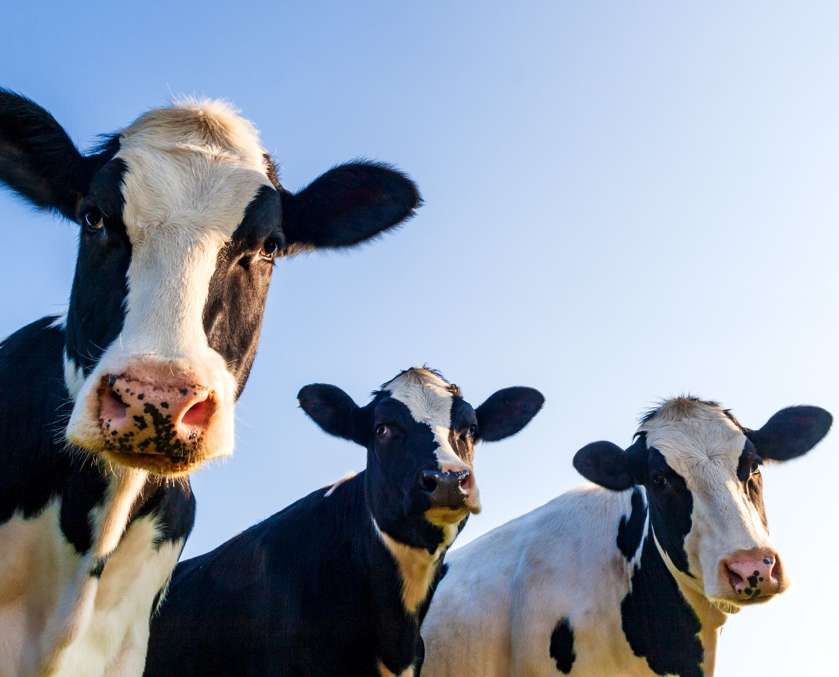
A picture is worth a thousand words
Every news post needs a story and will tools like canva you don’t even need to be a graphic designer…
… now it’s time to put the kettle on

Slide 12

Sharing your content
It’s not much point creating great content if we don’t tell people about it so we move on to the importance of social media.

Slide 13
How GREAT is your social media?
Are you posting on a regular basis? Do you the best times to post?
Are you writing about other people, community news and not just using it to sell? There is a 80/20 rule (a bit more about this later).
Are you taking your message outside of your network (in groups etc)?
Are you using most popular hashtags? Look at www.best-hashtags.com/hashtag/estateagents
Are you contributing to conversations in groups?
Are you asking questions? (Facebook Polls)

Slide 14

The bonus of this is that you’re ‘selling’ without ‘selling’ and are being relevant and Google loves that! It also makes you more aware of what’s going on!
Some ideas for the 80/20 rule… (80% of content you write and share should be informational/educational and 20% selling ie. promotional).
Can you link to anything newsworthy such as… green issues at the moment and then ask a question ‘Would you be looking for a perfect garden in your new home or a wilding garden #biodiversity?’
Link to the weather – always a hot topic! Such as ‘are you after a south-facing garden in your new home? #weather
Follow influencers/celebrities such as what do you think of George Clooney’s home? #georgeclooney

Slide 15
One step at a time
Social media is an enjoyable part of the job however it can be exhausting getting involved as there’s so much content and is harder to get found…but with a GREAT website, GREAT social media campaigns and other marketing tools such as email marketing, adverts, sponsorship, events etc. you should start to see an increase in your customers/sales by 3 months..
… If you need help get in touch

Slide 16
Coming Up..
More training!!

